Slide 1

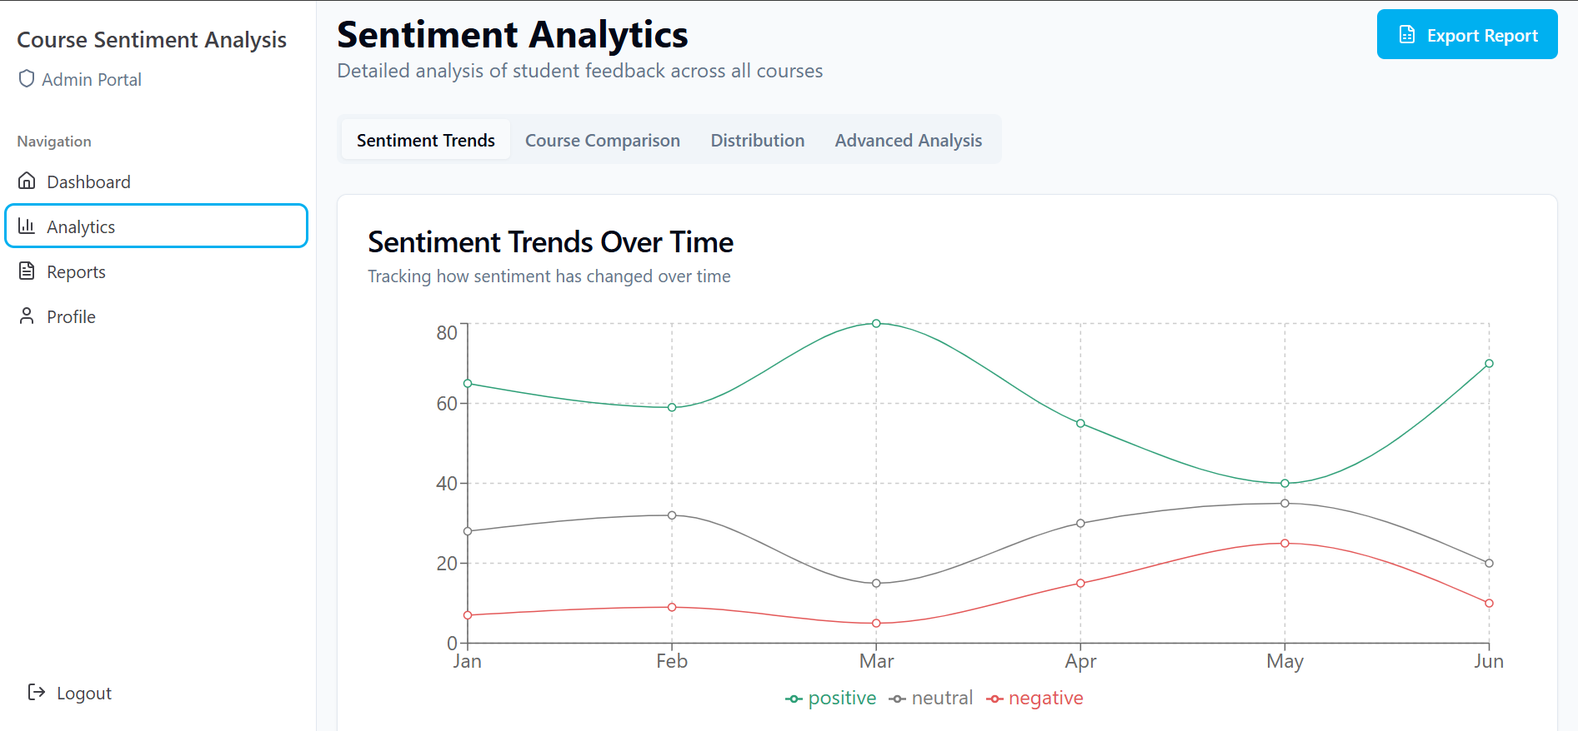
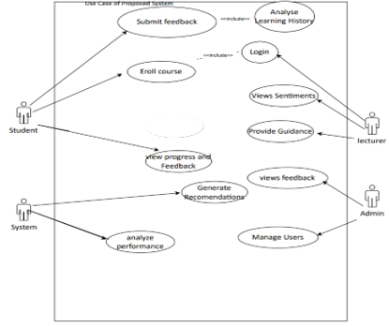
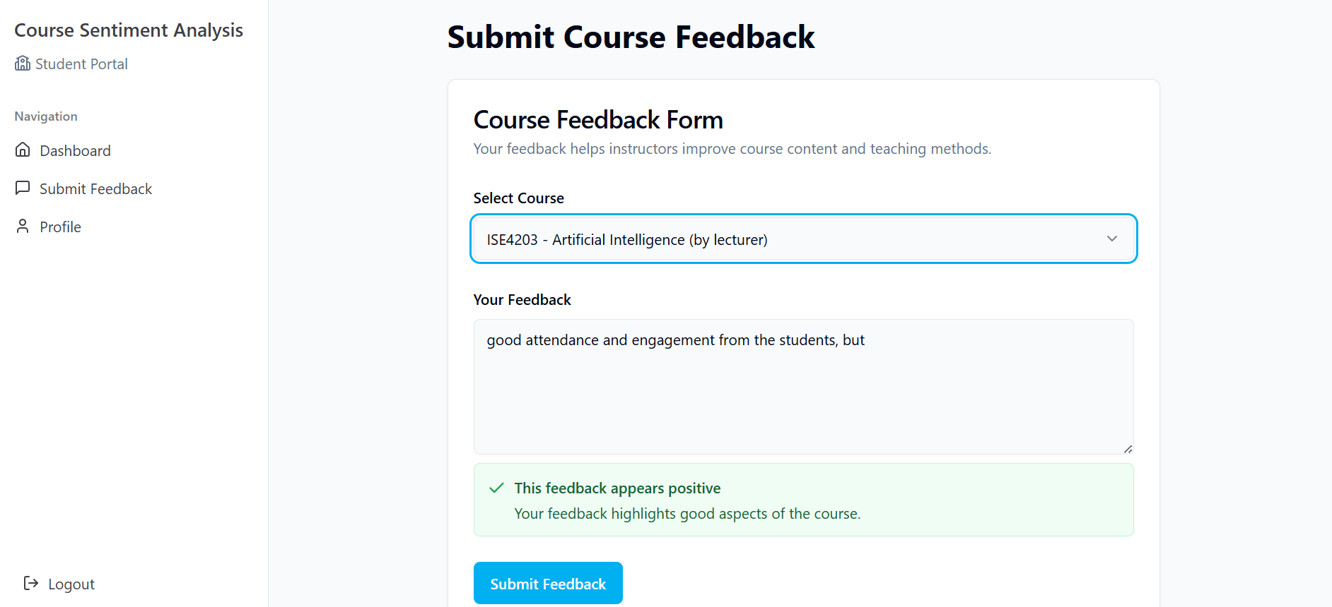
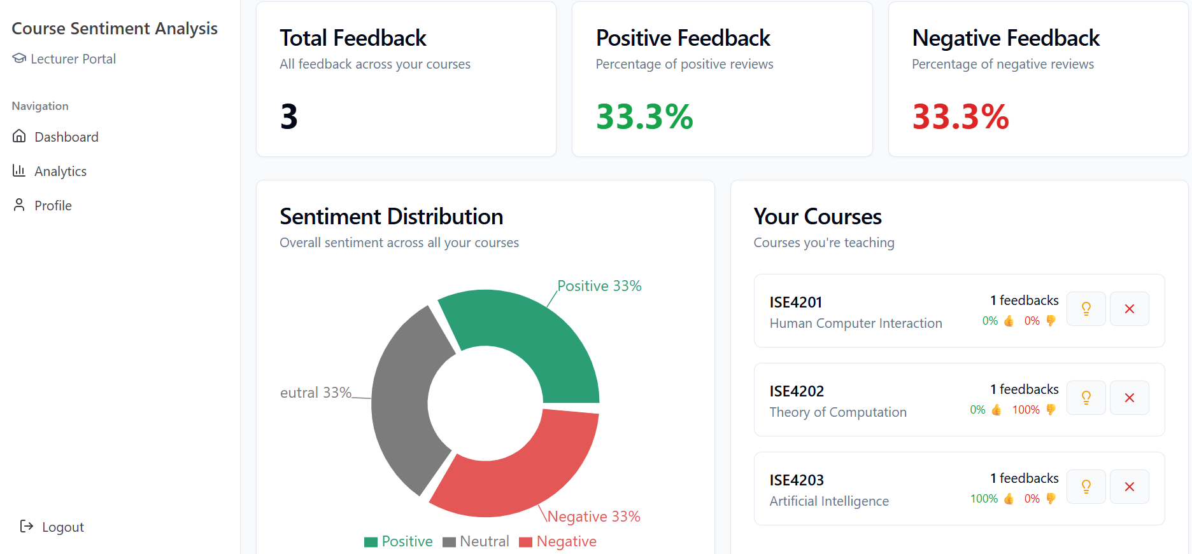
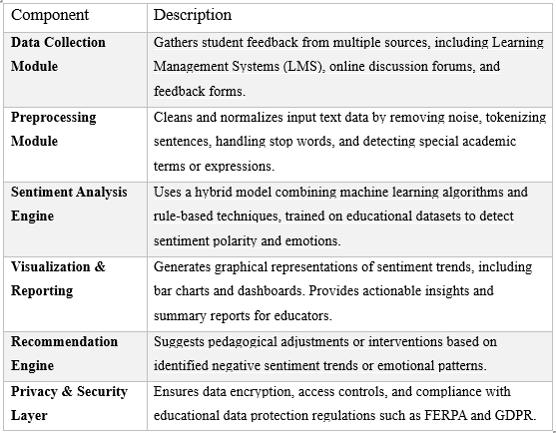
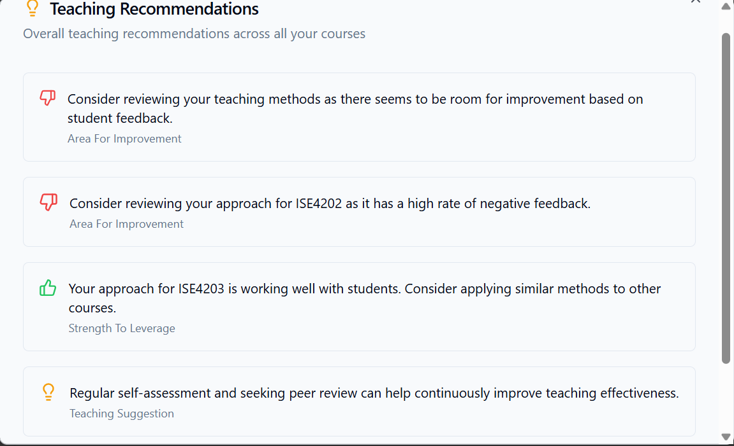
COURSE REVIEW USING SENTIMENT ANALYSIS
Kawara Davie Nigel
Mrs Chibaya(Supervisor)
Software Engineering Department
1.0 Abstract
Time Constraints: Manual evaluation of feedback is time-intensive, leading to delays in identifying and addressing student concerns
Missed Opportunities for Improvement: Without timely and accurate analysis of feedback, institutions miss opportunities to address issues, improve course quality, and foster a positive learning environment.
7.0. Use Case Diagram
The Project aims to analyze views or opinions expressed in textual data from students’ feedback after completing a course and provide relevant suggestions for improvement through automatically identifying the emotional tone expressed in the textual data which can either be positive, negative or neutral. The system will use machine learning and will be trained on a dataset of labelled text to analyze new or unseen text to determine its view or opinion and provide recommendations based on the insight gained.
The rapid adoption of online and blended learning environments has transformed the educational landscape, creating new opportunities for personalized and data-driven teaching strategies. In this context, gathering and analyzing student feedback has become a critical component of improving course quality and ensuring student satisfaction. Traditional methods of collecting and interpreting feedback, such as surveys and manual review, are often time-consuming, subjective, and limited in scope.
4.0. Overview of the developed application
General-purpose tools and open-source libraries lack the contextual understanding of academic feedback, while survey platforms and LMS modules often provide limited sentiment analysis capabilities.
These evaluations informed the decision to develop the proposed system, which:
Introduces domain-specific sentiment models,
Supports emotional state detection,
Offers real-time analysis and visualization,
Ensures compliance with educational data privacy standards.
The system provides a more robust, targeted, and effective solution for enhancing course review analysis in educational settings
Conclusion
Overall, the Sentiment Analysis System achieved its main objectives, including the accurate analysis of student feedback, providing actionable insights for educators. The system is functional, user-friendly, and secure. Moving forward, there are areas for improvement and additional features to explore such as Personalized Insights and Suggestions, Mobile Compatibility, Refine Sentiment Accuracy, but the current version of the system successfully meets its intended goals.
In conclusion, while the Sentiment Analysis System has made significant strides in improving the learning experience by providing valuable insights into student feedback, these challenges must be addressed to improve its accuracy, scalability, and user adoption. By continually refining the system, integrating new technologies, and ensuring ethical considerations, the system can evolve into an even more powerful tool for enhancing education.
8.0. Screenshots
2.0. Introduction
5.0. Objectives
The advent of sentiment analysis, a subset of natural language processing (NLP), offers a powerful solution for automating the analysis of textual feedback. By leveraging machine learning and NLP techniques, sentiment analysis can extract emotional tones from student feedback, providing educators with actionable insights into student engagement, satisfaction, and areas of improvement. However, most existing sentiment analysis systems are designed for business or general use cases and are not tailored to the unique needs of the educational sector.
This project aims to bridge this gap by developing a Sentiment Analysis System for Education that enables institutions to analyze course reviews, discussion forums, and other textual interactions. This system will empower educators to identify trends in student sentiment, make data-driven decisions, and enhance the learning experience.
To classify student feedback into positive, negative, or neutral sentiments using advanced natural language processing techniques.
To provide real-time sentiment analysis results for timely interventions and decision-making.
To generate detailed reports and visualizations that highlight trends in student engagement and satisfaction.
To enhance teaching methods and course design based on insights derived.
6.0. System Overview
References
1. Juraf-sky, D., & Martin, J. H. (2020). Speech and Language Processing: An Introduction to Natural Language Processing, Computational Linguistics, and Speech Recognition (3rd ed.). Pearson.
2. Liu, B. (2012). Sentiment Analysis and Opinion Mining. Synthesis Lectures on Human Language Technologies. Morgan & Claypool Publishers.
3. Pang, B., & Lee, L. (2008). Opinion Mining and Sentiment Analysis. Foundations and Trends in Information Retrieval, 2(1–2), 1-135.
4. Chen, M., Mao, S., & Liu, Y. (2014). Big Data: A Survey. Mobile Networks and Applications, 19(2), 171-209.
5. Kingma, D. P., & Ba, J. (2014). Adam: A Method for Stochastic Optimization. International Conference on Learning Representations (ICLR).
6. He, K., Zhang, X., Ren, S., & Sun, J. (2016). Deep Residual Learning for Image Recognition. In Proceedings of the IEEE Conference on Computer Vision and Pattern Recognition (CVPR).
3.0. Problem definition
Educational institutions face significant challenges in effectively analyzing and acting upon student feedback due to the following reasons:
Volume of Feedback: The large volume of textual feedback collected from course reviews, assignments, and discussion forums makes manual analysis impractical.
Unstructured Data: Student feedback is often unstructured, making it difficult to extract meaningful insights using traditional methods.

